Slide 1


SMART STREET LIGHT
K.RAMAKRISHNAN COLLEGE OF ENGINEERING
(Autonomous)
Accredited by NAAC with - 'A' Grade, NBA Accreditation of EEE
DEPARTMENT OF ELRCTRICAL AND ELECTRONICS ENGINEERING
BATCH NO : 13
GUIDED BY
Dr. R. MANIVASAGAM, M.E.,Ph.D. Professor
Electrical and Electronics Engineering
K.Ramakrishnan College of Engineering,
(Autonomous)
Samayapuram, Tiruchirappalli – 621 112

Slide 2
SMART STREET LIGHT
PRESENTED BY
ABIPRAKASH J - EE2105
SASIDHARAN A - EE2143
VISHNU R - EE2152
DHINESH S - LEE2157
Department of Electrical and Electronics Engineering
Third Year / 6th Semester
K.RAMAKRISHNAN COLLEGE OF ENGINEERING
(Autonomous)

Slide 3
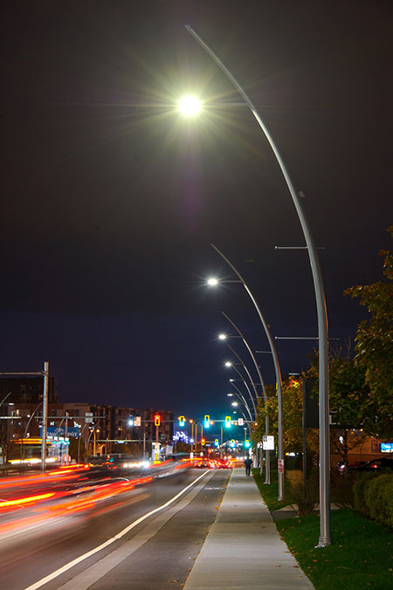
PROJECT TITLE
SMART STREET LIGHT

Slide 4
Introduction
Generally, street light controlling system is a simple concept which uses a transistor to turn ON in the night time and turn OFF during the day time.
The entire process can be done by a using a sensor namely IR (Infrared sensor).
Nowadays conserving the energy is an essential part and day by day energy resources are getting decreased. So our next generations may face a lot of problems due to this lack of resources.

Slide 5
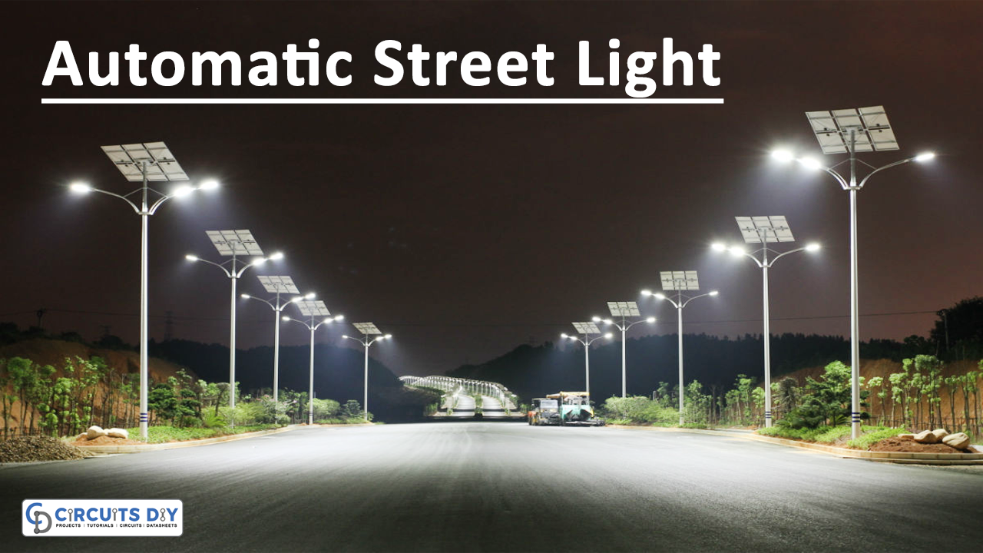
This system doesn’t need a manual operation to turn ON/OFF the street lights. The street light system detects whether there is need of light or not.

Slide 6
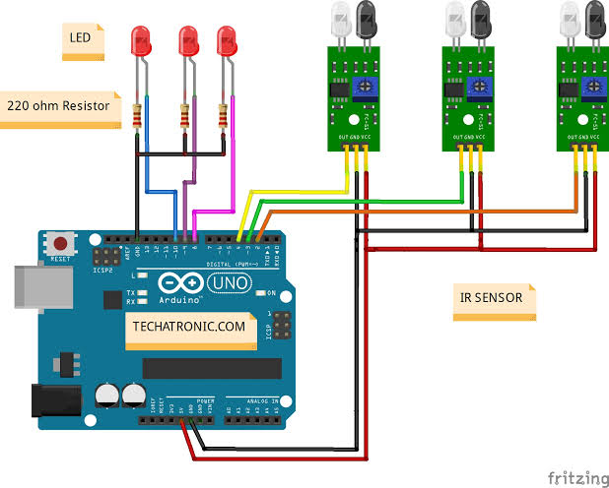
CIRCUIT DIAGRAM

Slide 7
Components
Arduino UNO
Battery
Resistor
IR Sensor(Transmitter & Receiver)
Row of Led
Connecting Wires

Slide 8
Operation
An automatic street light system that operates based on vehicle movement typically involves a combination of sensors, controllers, and lighting fixtures. Here's a basic overview of how it might work:
Motion Sensors: These sensors detect the movement of vehicles or pedestrians. In this case, vehicle motion sensors would be used to detect the presence of vehicles.

Slide 9
Microcontroller or Controller Unit: This is the brain of the system. It processes the input from the motion sensors and controls the operation of the street lights accordingly. A microcontroller such as Arduino or Raspberry Pi can be used for this purpose.
Relays or Switches: The microcontroller controls relays or switches that turn the street lights on or off.
Programming Logic: The microcontroller is programmed to turn on the street lights when it detects vehicle movement and turn them off after a certain period of time when there's no more movement.

Slide 10
Here's a step-by-step explanation of how the system might operate:
When a vehicle enters the vicinity of the street lights, the motion sensor detects its movement.
The motion sensor sends a signal to the microcontroller indicating that movement has been detected.
The microcontroller receives the signal and activates the relay or switch connected to the street lights.
The street lights turn on, illuminating the area.
The microcontroller also starts a timer to keep track of the duration since the last detected movement.

Slide 11
If no further movement is detected within a specified period (for example, a few minutes), the microcontroller turns off the street lights to save energy.
If movement is detected again during the time the lights are on, the timer is reset, and the lights remain on.
This cycle repeats each time movement is detected.

Slide 12
PROBLEM STATEMENT
Energy Efficiency: Traditional street lights lack adaptability, leading to wastage during off-peak hours and increased electricity costs.
Maintenance Costs: Manual inspections and reactive maintenance incur high expenses and safety risks, necessitating a more proactive approach.
Adaptability to Environmental Conditions: Current systems fail to adjust lighting levels in real-time based on factors like weather and pedestrian traffic, compromising both safety and efficiency.
Integration with Smart City Infrastructure: Street lights must seamlessly integrate with urban systems like traffic management and environmental monitoring for enhanced functionality and data-driven decision-making.

Slide 13
DATA COLLECTION
Light Intensity and Ambient Light Levels: Monitoring the intensity of ambient light helps determine when street lights should be activated or dimmed, optimizing energy consumption while ensuring adequate illumination.
Motion and Presence Detection: Utilizing sensors to detect motion and presence of pedestrians and vehicles helps adjust lighting levels dynamically, enhancing safety and security while minimizing energy waste in low-traffic areas.
Energy Consumption Monitoring: Collecting data on energy consumption allows for the identification of patterns and inefficiencies, enabling proactive measures to optimize energy usage and reduce operational costs.
Remote Monitoring of Fixture Health: Implementing sensors to monitor the health and performance of street light fixtures remotely facilitates predictive maintenance, reducing downtime and maintenance costs by detecting faults before they escalate

Slide 14
PROPOSE METHODOLOGY
Assessment of Existing Infrastructure:
Evaluate current street lighting infrastructure, including fixtures, energy consumption, and maintenance history.
Identify areas for improvement and optimization based on assessment findings.
Stakeholder Engagement:
Engage with city officials, residents, and stakeholders to understand needs and gather feedback.
Incorporate stakeholder input into the planning and implementation process for better alignment.
Technology Selection:
Research and select appropriate sensor technology, communication protocols, and control systems.
Ensure chosen technologies align with requirements, budget constraints, and scalability.
Pilot Deployment:
Conduct a small-scale pilot deployment to test technology effectiveness and feasibility.
Gather data and feedback from the pilot to inform larger-scale deployment plans.

Slide 15
5.Integration with Smart City Infrastructure:
Ensure compatibility and integration with existing smart city systems like traffic management.
Facilitate seamless data exchange and coordination between different urban infrastructure components.
6.Remote Monitoring and Management:
Implement centralized control for remote monitoring, management, and maintenance.
Enable proactive maintenance and troubleshooting to minimize downtime and disruptions.
7.Performance Monitoring and Optimization:
Continuously monitor performance metrics like energy savings and maintenance costs.
Use data insights to refine system performance and address any identified issues.

Slide 16
CONCLUSION
Smart street lighting consumes the energy efficiently with the help of solar panel. It also reduces the manual work of controlling the lighting systems. Motion detection of the object is made and the street lights are switched ON and OFF according to that.

Slide 17


